Slide 1
Re-Architecting Apache Spark for Performance Understandability
Kay Ousterhout
Joint work with Christopher Canel, Max Wolffe,
Sylvia Ratnasamy, Scott Shenker

Slide 2
About Me
PhD candidate at UC Berkeley
Thesis work on performance of large-scale distributed systems
Apache Spark PMC member

Slide 3
About this talk
Future architecture for systems like Spark
Implementation is API-compatible with Spark
Major change to Spark’s internals (~20K lines of code)
Notes:
If you’re thinking about building a system like Spark from scratch, this is one way you might think about doing it
Not something I’d expect to be merged into master in the near term.

Slide 4


rdd.groupBy(…)…
Spark cluster is a black box, runs the job fast

Slide 5
rdd.groupBy(…)…
Idealistic view: Spark cluster is a black box, runs the job fast

Slide 6
rdd.groupBy(…)…
Idealistic view: Spark cluster is a black box, runs the job fast

Slide 7
rdd.groupBy(…)…rdd.reduceByKey(…)…
Configuration:
spark.serializer KryoSerializer
spark.executor.cores 8
Idealistic view: Spark cluster is a black box, runs the job fast

Slide 8
rdd.groupBy(…)…rdd.reduceByKey(…)…
Configuration:
spark.serializer KryoSerializer
spark.executor.cores 8
Realistic view: user uses performance characteristics to tune job, configuration, hardware, etc.

Slide 9
Users need to be able to reason about performance
rdd.groupBy(…)…rdd.reduceByKey(…)…
Configuration:
spark.serializer KryoSerializer
spark.executor.cores 8
Realistic view: user uses performance characteristics to tune job, configuration, hardware, etc.
Notes:
Users must be able to reason about performance in order to get the fastest job runtimes! It’s not enough just for the framework to be fast – if the user can’t reason about bottlenecks, she can’t choose the best configuration / environment for the job.

Slide 10
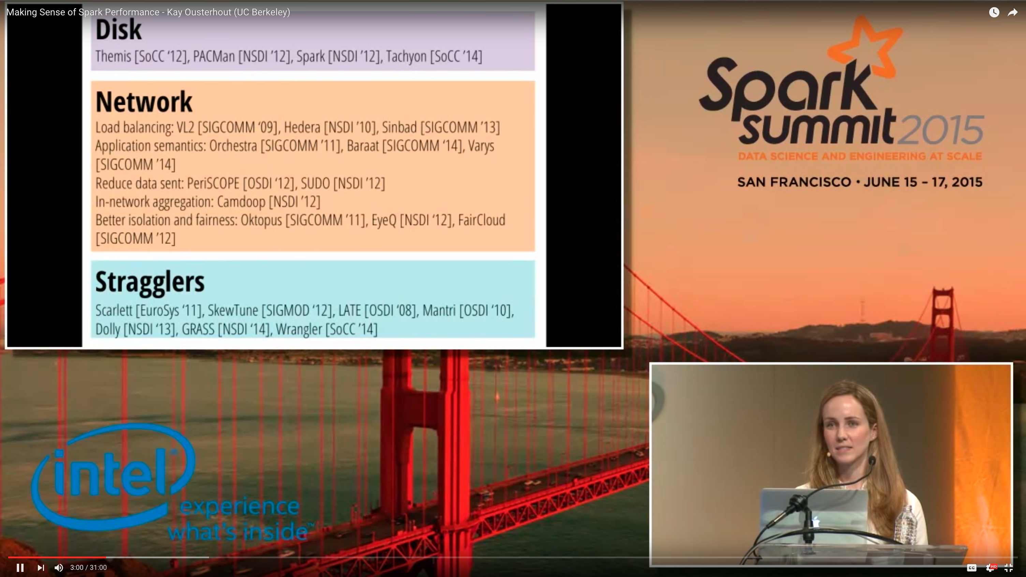
Reasoning about Spark Performance
Widely accepted that network and disk I/O are bottlenecks
CPU (not I/O) typically the bottleneck
network optimizations can improve job completion time by at most 2%
Notes:
How easy is this to do today?
Reasoning about performance is hard! Evidence: misunderstanding about what’s important to performance

Slide 11
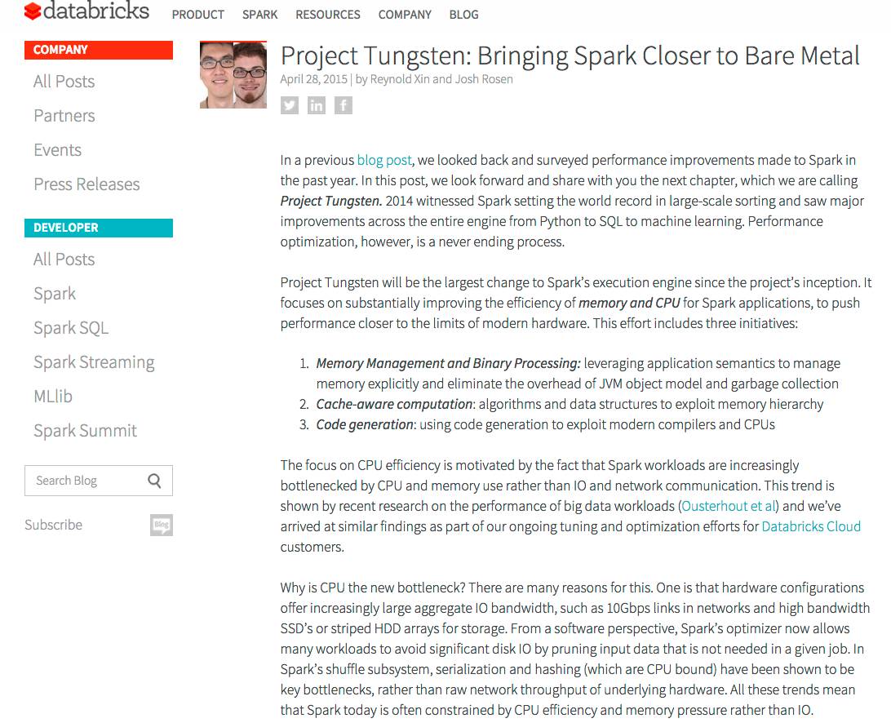
Reasoning about Spark Performance
Spark Summit 2015: CPU (not I/O) often the bottleneck
Project Tungsten:
initiative to optimize Spark’s CPU use, driven in part by our measurements

Slide 12
Reasoning about Spark Performance
Spark 2.0:
Some evidence that I/O is again the bottleneck [HotCloud ’16]
Spark Summit 2015: CPU (not I/O) often the bottleneck
Project Tungsten:
initiative to optimize Spark’s CPU use
Notes:
Point: it’s evolving w/ hardware, workloads, software changes, need some easy way to reason about this

Slide 13
Users need to understand performance to extract the best runtimes
Reasoning about performance is currently difficult
Software and hardware are constantly evolving, so performance is always in flux

Slide 14
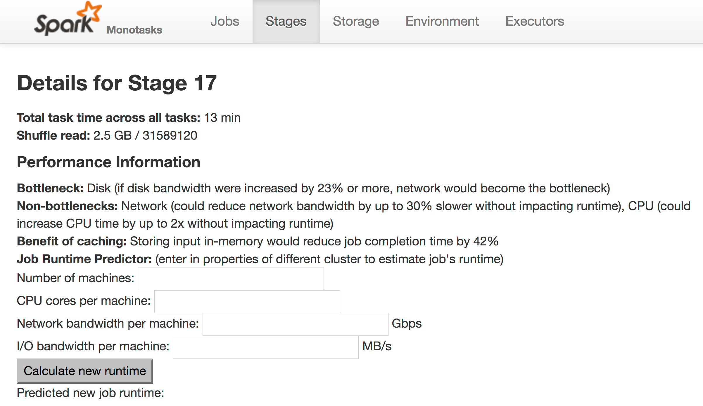
Vision: jobs report high-level performance metrics

Slide 15
Vision: jobs report high-level performance metrics

Slide 16
Vision: jobs report high-level performance metrics

Slide 17
Vision: jobs report high-level performance metrics

Slide 18
How can we achieve this vision?
Spark overview
Reasoning about Spark’s performance: why it’s hard
New architecture: monotasks
Reasoning about monotasks performance: why it’s easy
Monotasks in action (results)

Slide 19
Task 1:
Read and filter block 1
write result to disk
Task 5:
Read and filter block 5
write result to disk
Task 2:
Read and filter block 2
write result to disk
Task 6:
Read and filter block 6
write result to disk
Example Spark Job:
Read remote data
Filter records
Write result to disk
Task 3:
Read and filter block 3
write result to disk
…
Task n:
Read and filter block n
write result to disk
Task 4:
Read and filter block 4
write result to disk
Notes:
Aside: this is how Spark works, but lots of other frameworks too!

Slide 20
Fixed number of “slots”
Task 1
Task 9
Task 17
Task 2
Task 10
Worker 1
Task 3
Task 11
Task 19
Task 4
Task 12
Example Spark Job:
Read remote data
Filter records
Write result to disk
Task 5
Task 13
Task 18
Worker 2
Task 6
Task 14
Task 7
Task 15
Task 8
Task 16
…
time
Notes:
Aside: this is how Spark works, but lots of other frameworks too!

Slide 21
Task 1
Task 1
Task 9
Task 17
Task 2
Task 10
Worker 1
Task 1:
Read block 1, filter, write result to disk
Task 3
Task 11
Task 19
Task 4
Task 12
Task 5
Network read
Task 13
Task 18
Worker 2
Task 6
Task 14
CPU (filter)
Task 7
Task 15
Task 8
Task 16
Disk write
…
time
Notes:
Fine grained pipelining to parallelize use of difference resources.

Slide 22
How can we achieve this vision?
Spark overview
Reasoning about Spark’s performance: why it’s hard
New architecture: monotasks
Reasoning about monotasks performance: why it’s easy
Monotasks in action (results)

Slide 23
Task 19
Task 1
Task bottlenecked on disk write
Network read
Task 18
CPU (filter)
Task bottlenecked on network read
Disk write
Challenge 1: Task pipelines multiple resources,
bottlenecked on different resources at different times
Notes:
Fine grained pipelining to parallelize use of difference resources.

Slide 24
Task 1
Task 9
4 concurrent tasks on Worker 1
Task 2
Task 10
Task 3
Task 11
Task 4
Task 12
time

Slide 25
Task 1
Task 9
Challenge 2: Concurrent tasks may contend for
the same resource
(e.g., network)
Task 2
Task 10
Task 3
Task 11
Task 4
Task 12
time
Notes:
As a result of challenge #2: to understand what’s going on with any one of these tasks, need to understand the other ones.

Slide 26
Spark Summit 2015:
Blocked time analysis: how quickly could a job have completed if a resource were infinitely fast? (upper bound)
Result of ~1 year of adding metrics to Spark!

Slide 27
Task 1
Task 9
How much faster would the job be with 2x disk throughput?
Task 2
Task 10
How would runtimes for these disk writes change?
Task 3
Task 11
How would that change timing of (and contention for) other resources?
Task 4
Task 12

Slide 28
Challenges to reasoning about performance
Tasks bottleneck on different resources at different times
Concurrent tasks on a machine may contend for resources
No model for performance

Slide 29
How can we achieve this vision?
Spark overview
Reasoning about Spark’s performance: why it’s hard
New architecture: monotasks
Reasoning about monotasks performance: why it’s easy
Monotasks in action (results)

Slide 30
Spark:
Tasks bottleneck on different resources
Concurrent tasks may contend
No model for performance

Slide 31
Spark:
Monotasks: Each task uses one resource
Tasks bottleneck on different resources
Network monotasks:
Each read one remote block
…
Example Spark Job:
Read remote data
Filter records
Write result to disk
Concurrent tasks may contend
CPU monotasks:
Each filter one block, generate serialized output
…
No model for performance
Disk monotasks:
Each writes one block to disk
…

Slide 32
Spark:
Monotasks:
Dedicated schedulers control contention
Network scheduler
Tasks bottleneck on different resources
Each task uses one resource
…
…
One task per CPU core
Concurrent tasks may contend
CPU scheduler
…
…
No model for performance
Disk scheduler
One task per disk
…
…
time

Slide 33
Spark:
Monotasks:
Monotask times can be used to model performance
Tasks bottleneck on different resources
Each task uses one resource
Ideal CPU time: total CPU monotask time / # CPU cores
Concurrent tasks may contend
Dedicated schedulers control contention
No model for performance

Slide 34
Spark:
Monotasks:
Monotask times can be used to model performance
Tasks bottleneck on different resources
Each task uses one resource
Ideal CPU time: total CPU monotask time / # CPU cores
Concurrent tasks may contend
Dedicated schedulers control contention
Job runtime: max of ideal times
No model for performance
Ideal network runtime
Ideal disk runtime

Slide 35
Spark:
Monotasks:
How much faster would the job be with 2x disk throughput?
Tasks bottleneck on different resources
Each task uses one resource
Ideal CPU time: total CPU monotask time / # CPU cores
Concurrent tasks may contend
Dedicated schedulers control contention
Ideal network runtime
No model for performance
Monotask times can be used to model performance
Ideal disk runtime

Slide 36
Spark:
Monotasks:
How much faster would the job be with 2x disk throughput?
Tasks bottleneck on different resources
Each task uses one resource
Ideal CPU time: total CPU monotask time / # CPU cores
Concurrent tasks may contend
Dedicated schedulers control contention
New job runtime
Ideal network runtime
No model for performance
Monotask times can be used to model performance
Ideal disk runtime
(2x disk concurrency)

Slide 37
How does this decomposition work?
Spark:
Monotasks:
Network monotasks
…
Tasks bottleneck on different resources
Each task uses one resource
Compute monotasks: one task per CPU core
Task 1
Task 9
Concurrent tasks may contend
Task 2
Task 10
…
Dedicated schedulers control contention
Task 3
Task 11
No model for performance
Disk monotasks: one per disk
Monotask times can be used to model performance
Task 4
Task 12
…
Notes:
Gave up pipelining, replaced it with multiplexing!

Slide 38
How does this decomposition work?
Network read
CPU
Disk write
Task 1
Monotasks
Network monotask
Compute monotask
Disk monotask
Notes:
Undoing pipelining: age-old technique for optimizing performance!
Enough small tasks that this is ok.

Slide 39
Implementation
API-compatible with Apache Spark
Workloads can be run on monotasks without re-compiling
Monotasks decomposition handled by Spark internals
Monotasks works at the application level
No operating system changes

Slide 40
How can we achieve this vision?
Spark overview
Reasoning about Spark’s performance: why it’s hard
New architecture: monotasks
Reasoning about monotasks performance: why it’s easy
Monotasks in action (results)

Slide 41
Performance on-par with Apache Spark
Big data benchmark
(SQL workload)

Slide 42
Performance on-par with Apache Spark
Block coordinate descent
(Matrix workload used in ML applications)
16 machines
Sort
(600 GB, 20 machines)

Slide 43
Monotasks in action
Modeling performance
Leveraging performance clarity to optimize performance

Slide 44
How much faster would jobs run if each machine had 2 disks instead of 1?
Predictions for different hardware within 10% of the actual runtime
Notes:
Takeaway: monotasks correctly predicts new runtimes. Note that this is non-trivial (e.g., no runtimes increased by a factor of 2!). Sometimes no bottleneck, sometimes bottleneck stops. Monotasks gets it correct in both cases.

Slide 45
How much faster would job run if data were de-serialized and in memory?
Eliminates disk time to read input data
Eliminates CPU time to de-serialize data
Notes:
This is often a tricky thing for folks to understand: has 2 benefits.

Slide 46
How much faster would job run if data were de-serialized and in memory?
Measuring (de) serialization time with Spark
Spark Task
(De) serialization pipelined with other processing for each record
Application-level measurement incurs high overhead
Network
Task 18
CPU
Disk write
: (de)serialization time

Slide 47
How much faster would job run if data were de-serialized and in memory?
Measuring (de) serialization time with Monotasks
Eliminating fine-grained pipelining enables measurement!
Original compute monotask
Un-rolled monotask
: (de)serialization time

Slide 48
How much faster would job run if data were de-serialized and in memory?
Sort
Eliminate disk monotask time
Eliminate CPU monotask time spent (de)serialiazing
Re-run model

Slide 49
Leveraging Performance Clarity to Improve Performance
Network
Schedulers have complete visibility over resource use
Framework can configure for best performance
…
…
CPU
…
…
Disk
…
…
time

Slide 50
Configuring the number of concurrent tasks
Monotasks better than any configuration:
per-resource schedulers automatically schedule with the ideal concurrency
Spark with different numbers of concurrent tasks

Slide 51
Future Work
Leveraging performance clarity to improve performance
Use resource queue lengths to dynamically adjust job
Automatically configuring for multi-tenancy
Don’t need jobs to specify resource requirements
Can achieve higher utilization: no multi-resource bin packing

Slide 52
Monotasks:
Network monotasks
…
Each task uses one resource
Compute monotasks: one task per CPU core
Dedicated schedulers control contention
…
Vision:
Spark always reports bottleneck information
Challenging with existing architecture
Monotask times can be used to model performance
Disk monotasks: one per disk
…
Interested? Have a job whose performance you can’t figure out? Email me: keo@cs.berkeley.edu

